Slide 1

Plug/Perf Relation to Seismic Events
July 2024

Slide 2
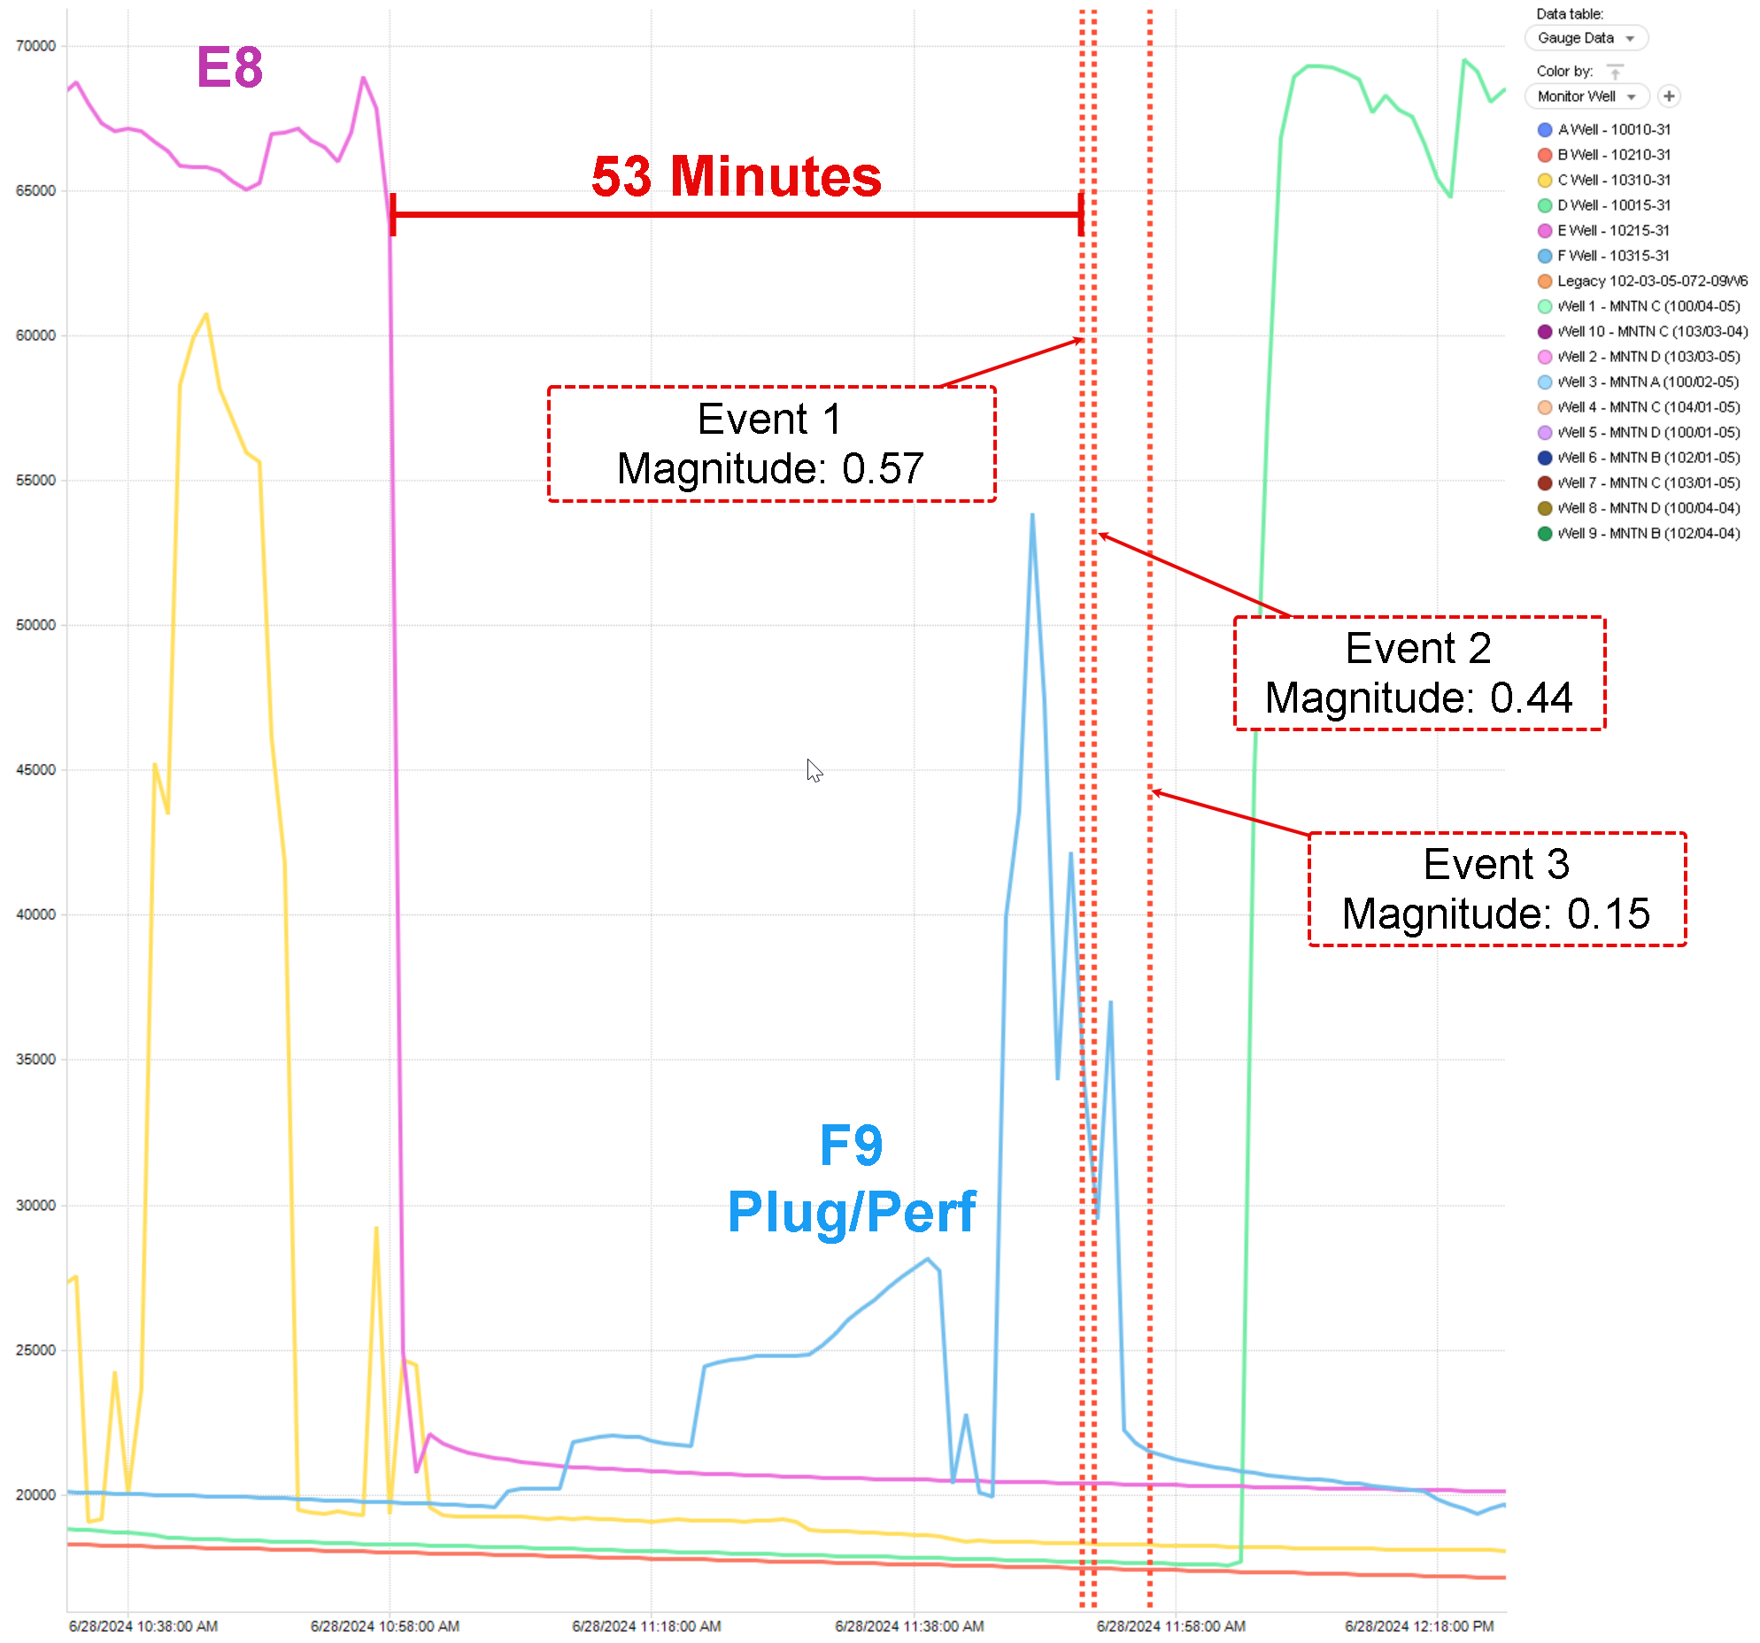
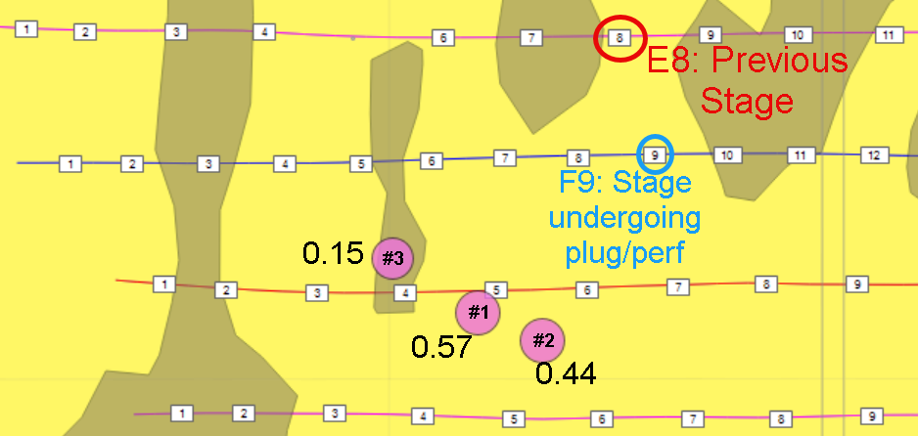
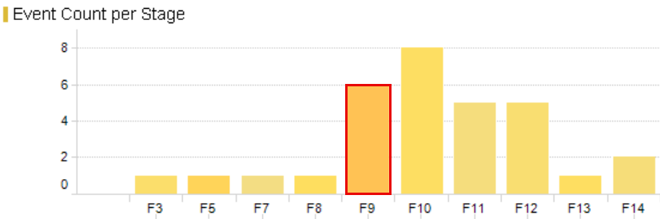
F9 Plug/Perf Relation to Seismic Events
Three spatially close seismic events occurred during the F9 plug/perf
while no stages were being pumped.
Previous stage E8 finished 53 minutes prior to first noted
seismic event, with zero seismic events recorded during E8.
First event possessed a relatively high magnitude of 0.57, greater
than 97.6% of recorded events – with magnitude of the events
decreasing with respect to time.
F9 showed strong seismic relations while pumping with an uptick
in event count and an above average magnitude of 0.20.

